Slide 1
Long Run Puzzles in Head Start Research
Doug Miller
War on Poverty conference
Center for Poverty Research
UC Davis, January 10, 2014

Slide 2
Long run Head Start Puzzles:
This talk
Brief history of Head Start, and history of related research debates
What we know, and why we know so little, about long run impacts
Advertisement / preview of ongoing work here at UC Davis

Slide 3
Long run Head Start Puzzles:
History
We all know and love Head Start
Not part of LBJ’s war on poverty speech!
Housed in Office of Economic Opportunity
Serendipitous alignment of:
  Excess CAP funds in first year – bad local politics – led to targeting children
  Personal history (Eunice Kennedy Shriver, Rosemary Kennedy, president’s panel on mental retardation)
  Legislative (Republican) & Administrative (HEW, Office of Ed) competition
“Project Rush-Rush” (eg, $180/kid)
Local (not state!) agencies applied directly to OEO

Slide 4
Long run Head Start Puzzles:
History
1965-1972: wild West (wild South?)
1973-1988: relative stability
1989-2001: massive expansion
2002-2010: relative stability
1965-today
  Perceived success!
Notes:
1968 NYC Mayor Lindsay: “Head Start has been one of the few real successes of OEO.”
Zigler and Muenchow’s 1992 books opens: “Why did head start succeed? A reporter asked me recently. And Why did the rest of the WoP fail?”
2003 Public opinion poll: 93% support for HS.

Slide 5


Head Start’s attraction: Fairness and Efficiency
Fairness: What a great target demographic!
Notes:
Kids age 3-4: mix of play and discovery; gaining in independent “person-hood” in eyes of the world; but still beyond blame.

Slide 6
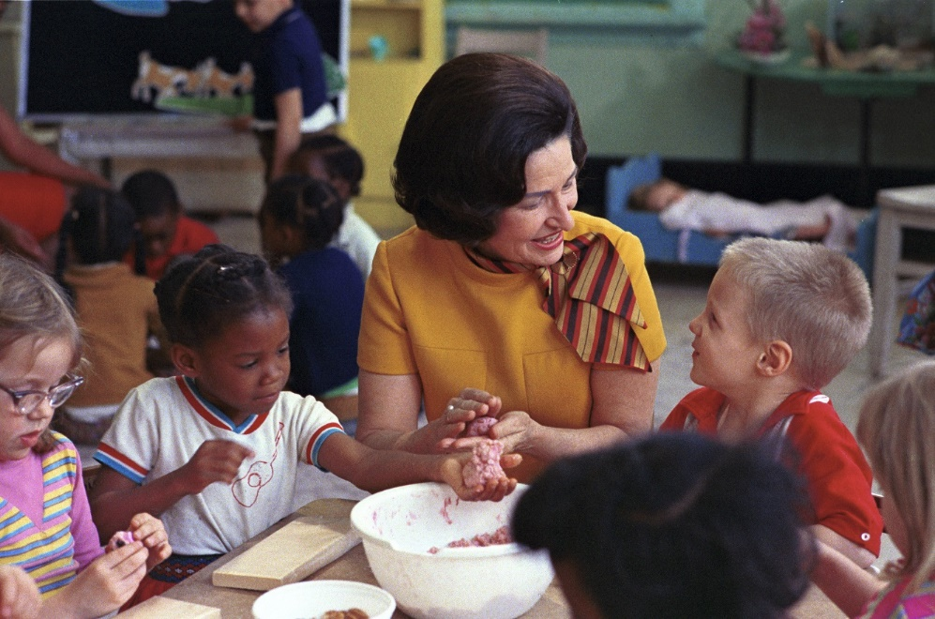

Head Start’s attraction: Fairness and Efficiency
Fairness: What a great target demographic!
Notes:
Not lost in terms of political imagery – Ladybird Johnson and Michelle Obama meeting with Head Start kids

Slide 7
Head Start’s attraction: Fairness and Efficiency
Efficiency: long-run impacts from investment in early childhood.
“Neuroplasticity”; “Dynamic complementarities in learning”
Ludwig & Phillips 2008: “The best available evidence suggests that Head Start probably passes a benefit–cost test.”
Notes:
President Clinton, joint session of congress, Feb 17, 1993, urging HS expansion “For every dollar we invest today, we'll save $3 tomorrow.”

Slide 8
Long run Head Start Puzzles, part 1:
Recurring debates 1965-2014
Does it work? And the question of “fade out” …
More vs. Less
And if more, “quantity” vs. “quality”
Academic vs “Whole Child”
Notes:
The title of this talk is Long run puzzles in Head start research. I mean that in two ways. The first way is that some of the puzzles, or debates, have a very long run history. From inception to today, the academic and policy debates about head start have recapitulated themselves since the beginning.
Fade out: 1965, 10 point IQ gains reported; By 1966, NYC reports of “fade out” to zero; April 1969 Westinghouse report, fade-out; NHSIS today.
Quantity vs. quality – Shriver consulted with Harvard early child experts, they didn’t like cheap cost of HS, he turned to long-time scientific advisers…
Summer 1965, Shriver to Jule Sugarman: “Now, I want to prove this program is valuable. In fact, I’d like to say how many IQ points are gained for every dollar invested.” JS: “Sarge, that’s only part of what Head Start is all about” SS: “I want it done.”

Slide 9
Long run Head Start Puzzles, part 2:
What is the long-run impact?
This is the key question. But it’s hard!
Short-run impact is hard to measure
  Perennial challenge of identifying causal effects from nonexperimental settings:
    Those who don’t sign up for HS are bad comparisons to those who do
Notes:
The other meaning of the title of this talk is: there are still puzzles about the long-run impact of HS. Getting at this is hard – for reasons we all know, but let me refresh.
HS participation requires:
Poverty
Parental initiative
Parental flexibility w.r.t scheduling
(Often) selection by HS center

Slide 10
Long run Head Start Puzzles, part 2:
What is the long-run impact?
Short-run impact is hard to measure
Economists’ approach: quasi-experiments
Many of the confounding variables are correlated with “demand for Head Start,” so …
Identify a “supply shock”
  Ideally one that’s not correlated with other determinants of long-run outcomes
Notes:
Head Start’s funding structure may enable this
Federally determined funding; local provision
Local supply = interaction of (local conditions) and (federal politics)
Example 1: Ludwig & Miller (2007)
Example 2: 1990s ramp up in funding

Slide 11
Long run Head Start Puzzles, part 2:
What is the long-run impact?
Short-run impact is hard to measure
Long-run impact is even harder!
  Same problems as SR. AND …
  Difficult to find data that links “LR outcomes” to “Head Start Exposure”
  … and also enables quasi-experimental variation!
Also, “external validity” issues
  Any valid estimate speaks only to
    The (population / program / alternatives) of the time
Notes:
At best, we can measure LR impact for the program and population from long ago
But we want to know impact of today’s program!

Slide 12
Long run Head Start Puzzles, part 2:
What is the long-run impact?
Ideal situation
  Identify LR impact from earlier cohorts
    AND impacts on SR outcomes for those cohorts
    Like “Intermediate Clinical Endpoints” and “Ultimate Clinical Endpoints” in medicine
  Find stable relationship between SR and LR outcomes
  Examine SR outcomes in today’s cohorts

Slide 13
Long run Head Start Puzzles, part 2:
What is the long-run impact?
Two types of “best available” direct measures of LR impacts:
Within-family sibling comparisons
  Currie & Thomas (1995, NLSY)
    Deming (2009)
  Garces, Thomas, & Currie (2002, PSID)
Early implementation grant-writing assistance
  Ludwig & Miller (2007)

Slide 14
Long run Head Start Puzzles, part 2:
What is the long-run impact?
Garces, Thomas, & Currie (2002)
 | ALL | AFRICAN-AMERICAN | WHITE
High School Grad | 0.037 | -0.025 | 0.203**
 | (0.053) | (0.065) | (0.098)
Some college | 0.092 | 0.023 | 0.281**
 | (0.056) | (0.066) | (0.108)
Booked/Charged w/ Crime | -0.053 | -0.116** | 0.122
 | (0.039) | (0.045) | (0.077)
N | 1,742 | 706 | 1,036

Slide 15
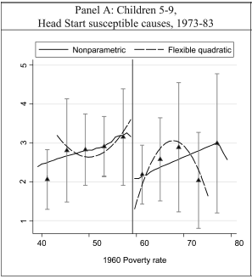
Long run Head Start Puzzles, part 2:
What is the long-run impact?
Ludwig & Miller (2007): discontinuity in grant writing assistance for Head Start.
  (+) schooling attainment ~ one half year
  (+) attending some college ~ 15% of the control mean.
  (-) child mortality

Slide 16
Long run Head Start Puzzles, part 2:
What is the long-run impact?
Promising, in-progress: Johnson (2013)
  PSID geo-coded to county-year funding data
  Panel FE design
  Beneficial impacts on Schooling, Wages, Incarceration, Health
The Optimistic take on LR impacts
  Johnson (2013): “Estimated long-term benefits for previous cohorts … From 3 separate research designs, three independent datasets (sibling difference, regression discontinuity, diff-in-diff)”

Slide 17
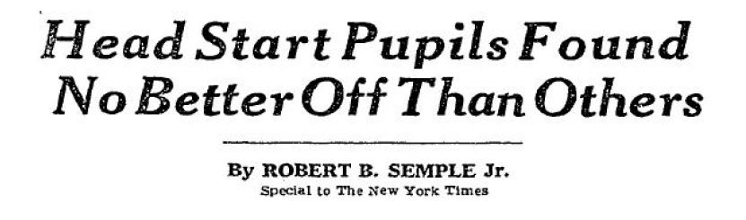
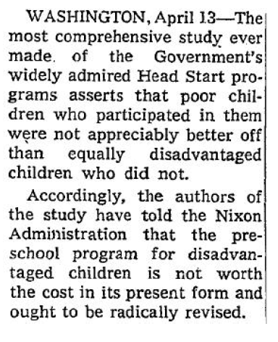
Long run Head Start Puzzles, part 2:
What is the long-run impact?
Is there a consensus? No!
NYT, Page A1, April 14, 1969
Test score fade out, Westinghouse report, 1969.

Slide 18
Long run Head Start Puzzles, part 2:
What is the long-run impact?
Is there a consensus? No!
Joe Klein, Time Magazine, July 2011
Test score fade out, NHSIS, 2010.
Randomized intervention = “gold standard”
TIME TO AX PUBLIC PROGRAMS THAT DON’T YIELD RESULTS
“…finally there is indisputable evidence about the program’s effectiveness, provided by the Department of Health and Human Services: Head Start simply does not work.”
“[Continued funding is ] criminal, every bit as outrageous as tax breaks for oil companies.”

Slide 19
Long run Head Start Puzzles, part 2:
What is the long-run impact?
Optimism: LR impacts
Pessimism: test score fade out
Optimism rejoinder 1: There was “fade out” for cohorts w/ LR impacts!
  Deming (2009)
  Ludwig & Miller, Garces Thomas & Currie, Westinghouse
  Also, Perry Preschool
  Also, Tennessee STAR
Optimism rejoinder 2: cognitive scores (1-2 years out) wrong “intermediate clinical endpoint”
  Some positive impacts w/in NHSIS
    Parent involvement (Gelber & Isen 2013)
    Subgroup (lower tail) impacts, non-cognitive skills (Bitler et al 2013)

Slide 20


Long run Head Start Puzzles, part 2:
What is the long-run impact?
(1) Optimism; (2) Pessimism; (3) Optimism rejoinders
(4) Pessimism rejoinder 1:
  NHSIS measured non-cognitive scores (zero effects)
  Is this a fishing expedition? We know what we want to find!
Pessimism rejoinder 2: the LR evidence is not bullet proof
Notes:
Occam’s razor suggests if it’s not there, it’s not there

Slide 21
Long run Head Start Puzzles, part 2:
What is the long-run impact?
Re-assessing the LR evidence: Ludwig-Miller (2007)
Educational gains?
  Marginal statistical significance.
  E.g. NELS, Yrs Schooling, +0.58, (T* = 1.55)
  E.g. Census, HS Grad, +0.03, (p value = 0.032)
  Concerns about migration
Health gains?
  “HS susceptible causes” = Anemias, Meningitis, Respiratory
  Small fraction of mortality then; much smaller now.

Slide 22
Long run Head Start Puzzles, part 2:
What is the long-run impact?
Re-assessing the LR evidence: Garces Thomas Currie (2002)
Well-known concerns about “sibling comparison” strategies
  Why did one child get exposure, the other did not?
  Back to problems w/ non-experimental research designs
Our replication & extension of G-T-C indicates:
  Sibling comparison estimates in PSID only suggestive, not definitive.

Slide 23
PSID sibling comparison analysis
Following G-T-C (2002), we re-construct PSID sample
Looks good for Means and (full sample) sample size, and “observational” regression.
Then we re-estimate “sibling comparison” regression …

Slide 24
PSID sibling comparison analysis
Sibling comparison sample, mother FE estimates
 |  | GTC (2002) |  |  |  | UC Davis Econ (2014)
 | ALL | AFRICAN-AMERICAN | WHITE |  | ALL | AFRICAN-AMERICAN | WHITE
High School Grad | 0.037 | -0.025 | 0.203** |  | 0.050 | -0.025 | 0.140
 | (0.053) | (0.065) | (0.098) |  | (0.054) | (0.057) | (0.088)
Some college | 0.092 | 0.023 | 0.281** |  | 0.097 | -0.008 | 0.230**
 | (0.056) | (0.066) | (0.108) |  | (0.059) | (0.054) | (0.098)
Booked/Charged w/ Crime | -0.053 | -0.116** | 0.122 |  | 0.052 | -0.050 | 0.230*
 | (0.039) | (0.045) | (0.077) |  | (0.036) | (0.042) | (0.13)
N | 1,742 | 706 | 1,036 |  | 1,554 | 627 | 924
Notes:
N for “all”: GTC= 3357, UC Davis = 3255

Slide 25
PSID sibling comparison analysis
Sibling comparison sample, mother FE estimates
Investigating the discrepancies, we learned:
  Smaller “N” than you might think!
Eg., African-American sibling sample, N = 627
  94% of which are in families with no Head Start switching
  About 50 children in “Head Start switching” families ..
  … of whom, about 13 kids booked/charged with a crime.
Notes:
No Head start switching for roughly: 84% of all kids; 70% of white kids.

Slide 26
PSID sibling comparison analysis
Sibling comparison sample, mother FE estimates
Next, we expand the sample
  Later cohorts
  Older siblings
  More than 3x sample size
Also, we examine longer-run outcomes (through mid-40’s)

Slide 27
PSID sibling comparison analysis
Sibling comparison sample, mother FE estimates
 |  | UCD Original Sample |  |  |  | UCD Expanded Sample
 | ALL | AFRICAN-AMERICAN | WHITE |  | ALL | AFRICAN-AMERICAN | WHITE
High School Grad | 0.050 | -0.025 | 0.140 |  | 0.011 | -0.016 | 0.034
 | (0.054) | (0.057) | (0.088) |  | (0.025) | (0.028) | (0.043)
Some college | 0.097 | -0.008 | 0.230** |  | 0.065** | -0.025 | 0.161***
 | (0.059) | (0.054) | (0.098) |  | (0.032) | (0.031) | (0.057)
Booked/Charged w/ Crime | 0.052 | -0.050 | 0.230* |  | 0.010 | -0.038 | 0.068
 | (0.036) | (0.042) | (0.13) |  | (0.029) | (0.024) | (0.055)
N | 1,554 | 627 | 924 |  | 5,341 | 2,347 | 2,988

Slide 28
PSID sibling comparison analysis
Sibling comparison sample, mother FE estimates
Also, we examine longer-run outcomes (through mid-40’s)
No impacts for:
  Cigarettes, drinks, SRHS, BMI, food stamps, TANF, ln(earnings), Employment, Unemployment

Slide 29
Long run Head Start Puzzles, part 2:
What is the long-run impact?
(1) Optimism; (2) Pessimism; (3) Optimism rejoinders; (4) Pessimism rejoinders
Reminder of the Ideal situation:
  LR impact from earlier cohorts
    AND SR outcomes for those cohorts
  Stable relationship between SR and LR
  SR outcomes today
We are a long way off!

Slide 30
Long run Head Start Puzzles:
This talk
Brief history of Head Start, and history of related research debates
What we know, and why we know so little, about long run impacts
Advertisement / preview of ongoing work here at UC Davis

Slide 31

Preliminary Results EULA
I acknowledge that the following results are based on extremely preliminary data analysis.
I expect that with further data and analysis work by the researchers, they will change.
I will not take these too seriously – they are intended as “proof of concept”
I may need to accept cookies to view these results.
  (The type you eat)

Slide 32
New work in progress:
Three projects in search of titles
“Untitled project: Head Start long run impact, PSID analysis”
“Untitled project: Head Start funding data, county-year and state-year panels”
“Untitled project: Head Start long run impact, rapid growth in funding during the 1990s”
Joint work with: Ariel Marek, Esra Kose, Michel Grosz, Na’ama Shenhav, Natalie Ho

Slide 33
2: “Untitled project: Head Start funding data, state-year and county-year panels”

Slide 34
State-Year Panel
Many sources of secondary data
  OEO reports
  Head Start Statistical Fact Sheets
  NCES digest
  Congressional Research Service Report
  GPO Budget reports
Funding and (sometimes) enrollment
Used in two ways
  Can validate later county-year panel
  Direct source of information on Head Start exposure
Also: population (3-4) and child poverty estimates

Slide 35
State-Year Panel
We have many years, but not all!

Slide 36
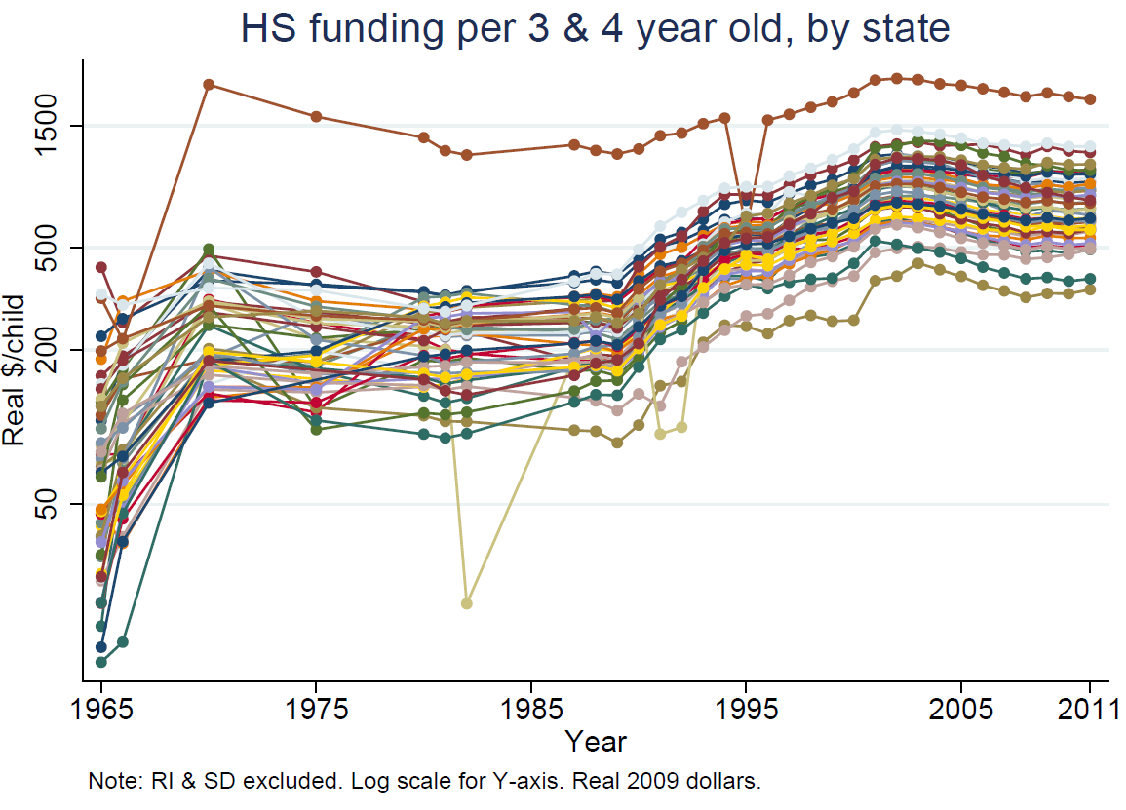
State-Year Panel

Slide 37
County-Year Panel
Community Action Program funding data (1965-1968)
Federal Outlay System Files (1968-1980)
These provide information on funding at the Program-County-year level.
Notes:
Reference to Martha’s Friday morning talk.

Slide 38
County-Year Panel
These data are very messy!
And without decent documentation
Three examples:
  “letters” instead of numbers in funding data.
  Amite County, MS, 1974
  New York and New Jersey, 1974
Lots of cleaning work done so far
  Lots more left to do
So far, data quality is a “decent start”
Notes:
Amite County: pop=14,000 in 1970, 1973=0.92, 1974=280.1, 1975=0.90; 3 centers; MS was huge outlier.
NJ: 1973=10, 1974=0.70, 1975=11.7
NY: 1973=17, 1974=0.44, 1975=28.5

Slide 39
County-Year Panel
Time series comparing county data against state-year panel and national time series.

Slide 40
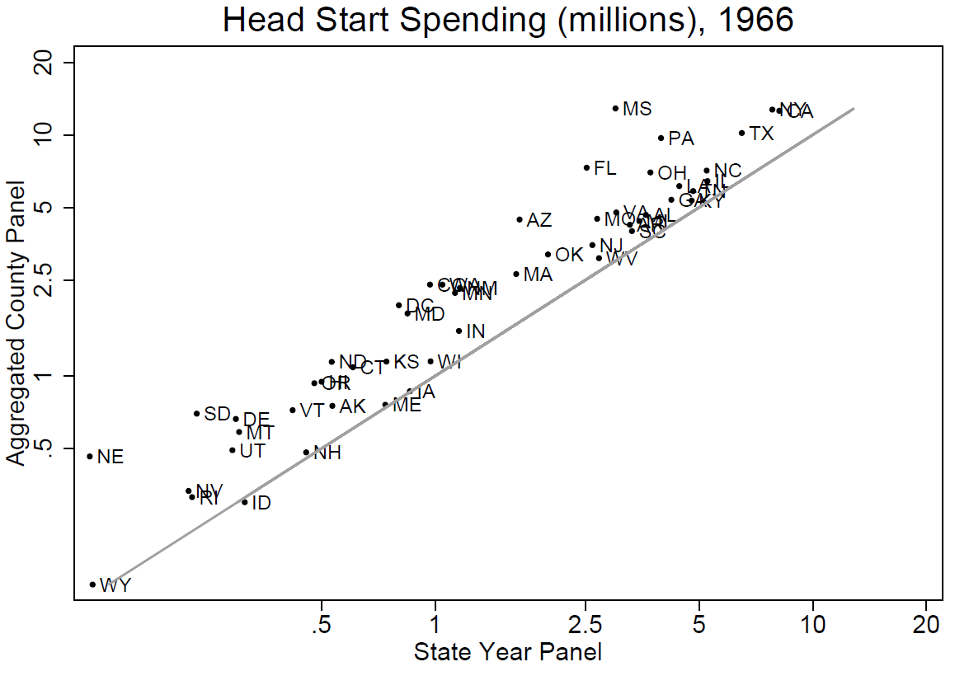
County-Year Panel
Cross section comparing county data against state-year panel. Log scale.
Notes:
The cross-state fit between the SY and CY panels is okay. This a poor fitting one; other years are better. Note log scale.

Slide 41
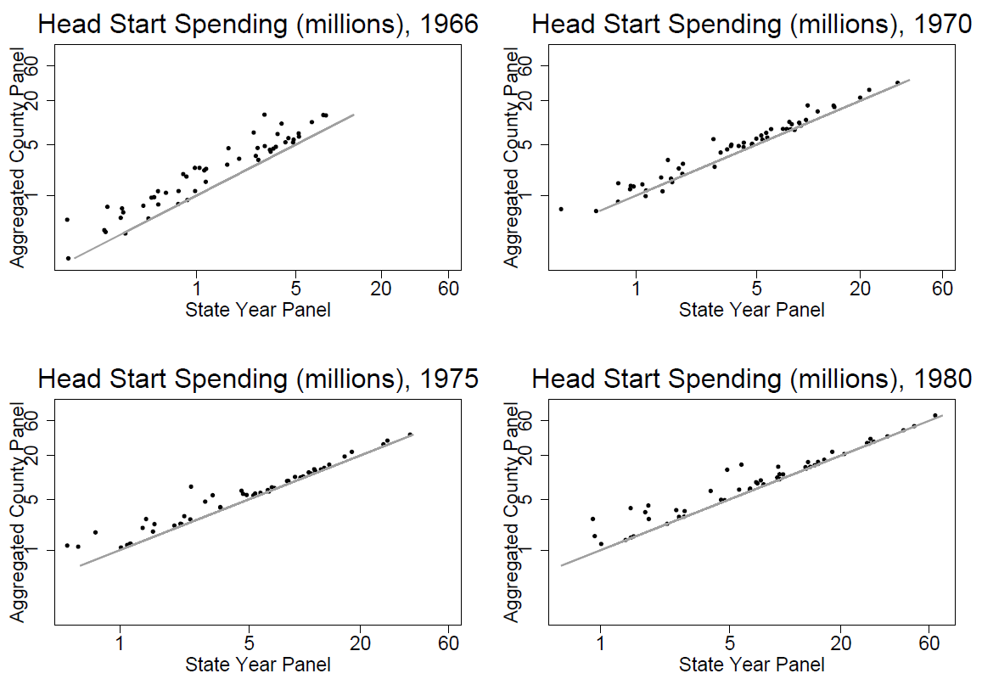
County-Year Panel
Cross sections comparing county data against state-year panel. Log scale.
Notes:
The cross-state fit between the SY and CY panels is okay. This a poor fitting one; other years are better. Note log scale.

Slide 42
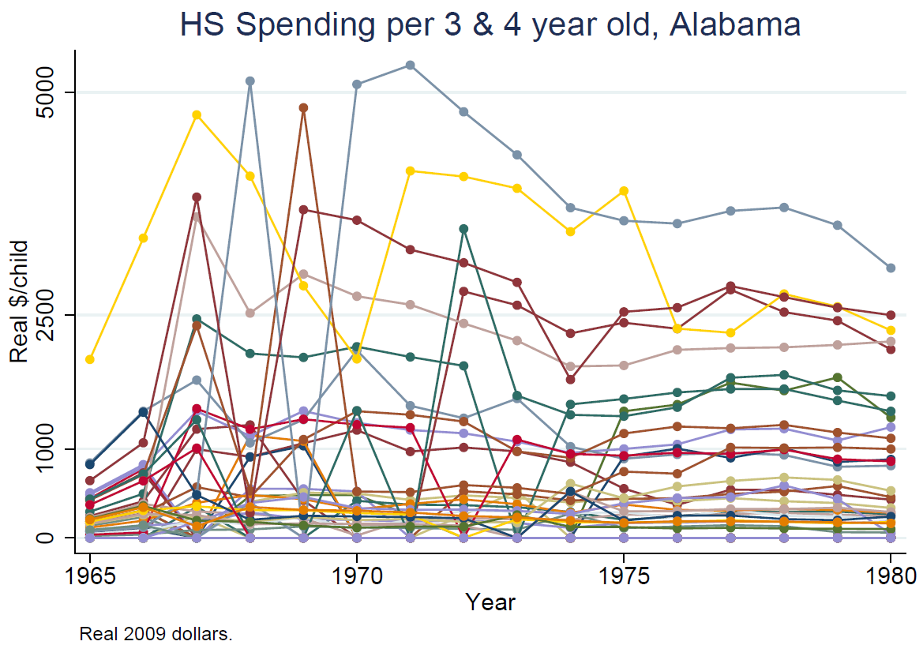
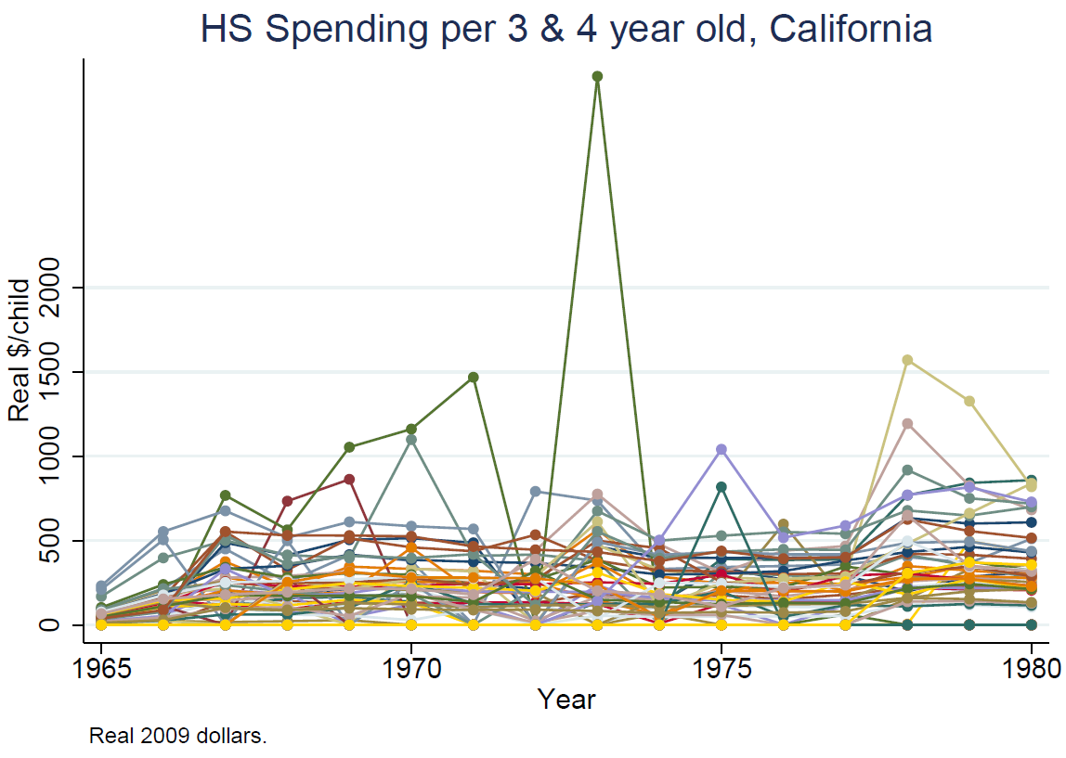
County-Year Panel
What does the data look like?
Notes:
The cross-state fit between the SY and CY panels is okay. This a poor fitting one; other years are better. Note log scale.

Slide 43
State-Year and County-Year Panels
Lessons learned
These data have potential, but require deep attention to cleaning.
Difficult to even know what to check against
I would welcome leads and suggestions

Slide 44
3: “Untitled project: Head Start long run impact, rapid growth in funding during the 1990s”
Notes:
One benefit from pulling together state-year funding panel is it lets us ask questions about the patterns in this funding. This offers scope to identify politically driven “arbitrary” changes to funding – which can enable learning about HS’s impacts. A first step is to examine the big changes in the 1990s.

Slide 45
Growth in HS funding 1990-2001
Big ramp up in 1990s!

Slide 46
Growth in HS funding 1990-2001
Big!
Equalizing across states
Not uniform across states
Left great amounts of variation
HS $ per poor 3-4 year old:

Slide 47
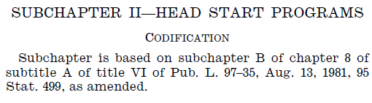
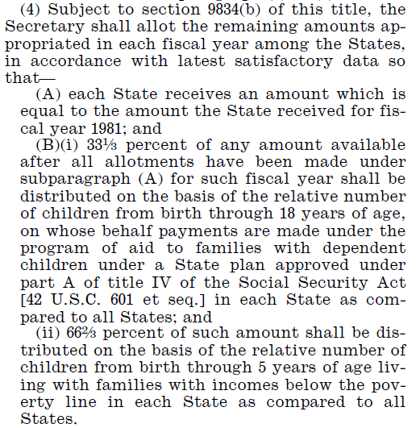
Growth in HS funding 1990-2001
What is behind variation in HS growth? One potential answer: legislative language.
We are collecting this for Head Start’s history. Example, USC 42, 1994:
Set asides
Each state gets its 1981 $$
Of the excess …
  1/3 based on 0-18 AFDC caseload
  2/3 based on 0-5 kids poverty

Slide 48
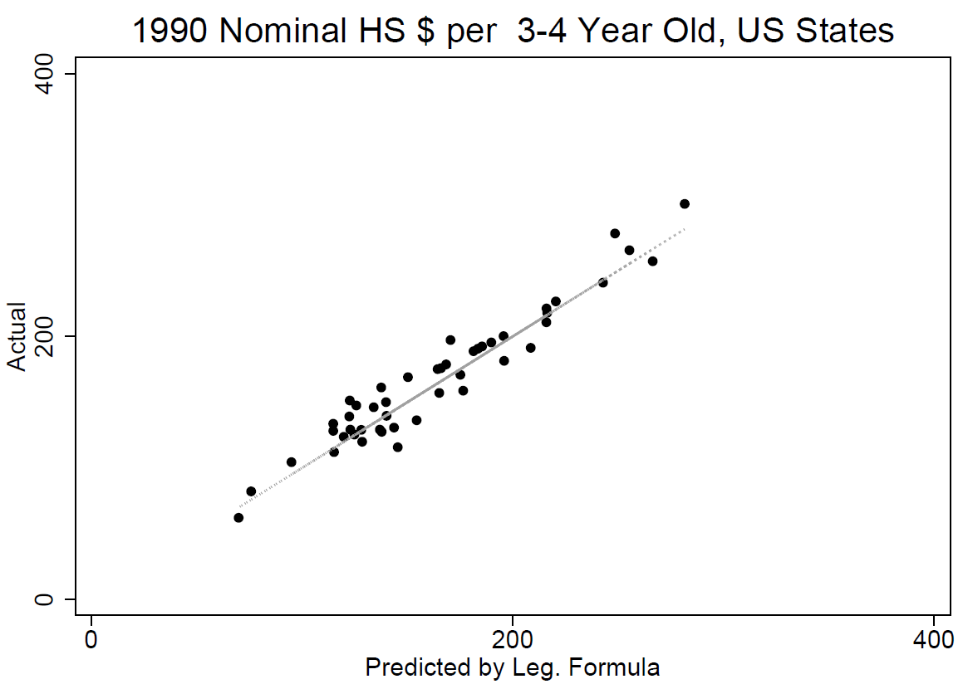
Growth in HS funding 1990-2001
Legislated formula and actual HS $
Notes:
Begs the question: does this funding formula actually predict real funding allocations? We used the formula, built up the pieces (# poor, # AFDC kids, 1981 levels, total national sum of funding) to get predicted values. Then ….
X-axis just comes from 4 pieces: 1981 nominal levels; state share of poor; state share of AFDC; national level of funding. Y-axis is actual amount state got. Line is 45 degree line, not regression line!

Slide 49
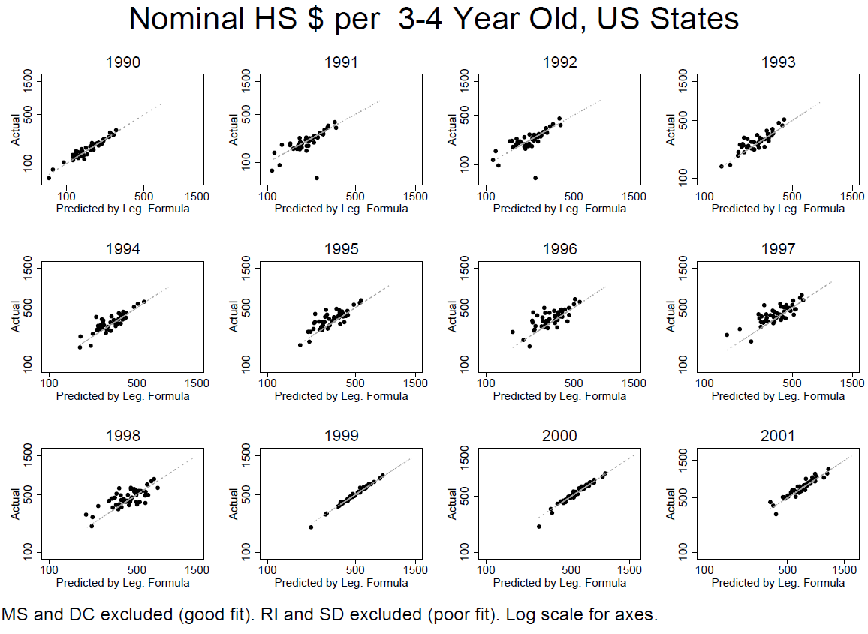
Growth in HS funding 1990-2001
Legislated formula and actual HS $
Notes:
Same exercise, one per year (1990, last slide, is in upper left corner). We see that the line fits well. Fit varies across years. See the growth, from SW to NE, over time. Legistlation changed in 1998, changing reference year from 1981 to 1998. See that in 1999 good fit.

Slide 50
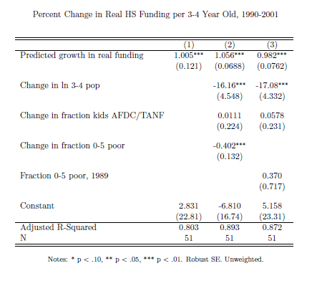
Growth in HS funding 1990-2001
Notes:
Weighted looks similar for main coeff. One-at-a-time control vars, only lagged fraction poor correlated. Main coefficient also robust to: change in share AFDC; change in share 0-5 poor. (ingredients in formula.)

Slide 51

Growth in HS funding 1990-2001
The promise of this research design: we only need to know state and cohort in order to get “treatment intensity”
  Many available datasets
  Many outcomes – including “intermediate clinical endpoints”
  Migration less of a concern
This design extends naturally to periods outside of “the ramp up”

Slide 52


Long run Head Start Puzzles:
Conclusion
We all know and love Head Start
But we don’t know as much as we should
Stay tuned …

