Slide 1

Randomized Controlled Trials in Community Colleges
Successes, Challenges, and Next Steps for Research on Developmental Education
U.C. Davis
March 16, 2015
Alexander K. Mayer
Research Associate, MDRC

Slide 2
Developmental Education
Community College Students
  Majority enters college under-prepared
  Financial need
  About 2/3 do not earn a degree or certificate within 6 years
Lots of reform
  Limited systematic research
  Status quo is changing – implications for research

Slide 3
Overview of Four Projects
Learning Communities
  Early evaluation and multi-site demonstration
Performance-based scholarships
  Early evaluation and multi-site demonstration
Comprehensive program
  ASAP
National center to study developmental education
  3 large studies and supplemental studies

Slide 4
Learning Communities

Slide 5
Kingsborough: Opening Doors
Learning Communities
Design – one semester:
  Co-enrollment
  Instructor collaboration
  Curricular integration
  Additional supports (counseling, tutoring, textbooks)
Theory of change
  Greater Engagement
  Stronger relationships
  Benefits of extra support

Slide 6
Early Results
Kingsborough Learning Communities
Strong implementation
  Support from college administration
  Students felt more integrated
Impacts during the program term
  Students attempted and passed more courses
  Earned more credits (about 1.2 credits)
  Advanced more quickly through developmental education
Impacts after 4 semesters
  No impact on persistence
  Earned more credits (about 2.4 credits)

Slide 7
Long-term Results
Long-term follow-up at Kingsborough

Slide 8
Learning Communities Demonstration
Queensborough
Community College:
Linked developmental math with a college-level course
Merced College:
Linked developmental
English and a variety of
courses
Kingsborough Community College:
Developmental only
Community College of
Baltimore County:
Linked developmental English, a college-level course, and seminar
Hillsborough
Community College:
Houston Community College:
Linked developmental reading with a student success course
Linked developmental math with a student success course

Slide 9
Results
Learning Communities Demonstration
0.6*
11.9
11.4
0.5***
6.4

Slide 10
Taking Stock:
Learning Communities
Variation in the programs across the demonstration
  Curricular integration was inconsistent
  Some scaling challenges, especially in first two semesters
Modest impacts in the short-term on average
  Can improve longer-term outcomes
Unanswered questions
  No clear explanation for better results at Kingsborough
  Impact of ideal program vs. as implemented?

Slide 11
Performance-Based Scholarships

Slide 12
Louisiana Results
Performance-Based Scholarships
Performance-Based Scholarships:
  Need-based grants
  Contingent on academic performance and/or student services
  Paid directly to students
  Paid in addition to other financial aid, such as Pell
Goals
  Address unmet financial need and make college more affordable
  Improve student success

Slide 13
Louisiana: Opening Doors
Performance-Based Scholarships
Student participants
  Most were women who were single parents
  $1,000/semester if enrolled half-time and earned a C average
Control group
  Less than 40% registered in 2nd and 3rd semesters
  After 3 semesters, average of 7.7 earned credits
Impacts
  Positively affected persistence in 2nd and 3rd semesters
  Earned more credits (3.3 credits)

Slide 14
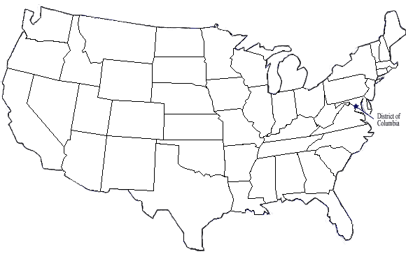
Performance-Based Scholarship Programs
Parents: Lorain County, Owens, and Sinclair Community Colleges (OH)
High school seniors:
California Cash for College (CA)
Adult learners:
Borough of Manhattan and Hostos Community Colleges (NY)
Developmental math sequence:
Hillsborough Community College (FL)
Hispanic males:
Pima Community College (AZ)
Parents: Delgado Community College and Louisiana Technical College (Opening Doors Demonstration)
Traditional college students:
University of New Mexico (NM)

Slide 15
Early Results
Performance-Based Scholarships
1.7 **
1.0
0.9 *
1.7 ***
3.3 ***
15

Slide 16
Taking Stock:
Performance-Based Scholarships
Programs adhered to core principles
  Flexibility to tailor programs to specific student needs
Modest but consistent impacts in the longer-term
  Including on degrees, and in some cases loans
  No effect on persistence
  Little detectable variation in impacts
Implications and unanswered questions
  Impacts on policy
  Scholarship size
  Services vs. no services

Slide 17
Comprehensive Reform
Accelerated Study in Associate Programs

Slide 18
Accelerated Study in Associate Programs
(ASAP)
Student Responsibility
Enroll Full-time
Take Dev. Ed. Early
Graduate in 3 Years
Financial Supports
Tuition Waiver
MetroCards
Textbooks
Student Services
Advising
Tutoring
Career Services
Course Enrollment
ASAP Seminar
Block-Schedule
Early Registration

Slide 19
Accelerated Study in Associates Program
ASAP
3-year Results
Program Group | Control Group | Difference
40% | 22% | 18
Graduation rates nearly doubled

Slide 20
ASAP: Next Steps
ASAP Replication
  Replication of ASAP in 3 Ohio colleges
  MDRC & CUNY exploring opportunities to bring ASAP to other communities
  Long-term follow-up

Slide 21
Center for the Analysis of
Postsecondary Readiness
MDRC, CCRC, and additional partners
Descriptive study of developmental education
  Large national survey and qualitative interviews
Assessment study
  RCT of new algorithms in colleges across New York
Instruction study
  RCT of the New Mathways Project in colleges across Texas

Slide 22
Contact Information
Alex Mayer
Research Associate
Alexander.Mayer@mdrc.org
Reports available at www.mdrc.org

